Slide 1
ISYE 7406 Project Presentation Group 250
Nathan Chan

Slide 2
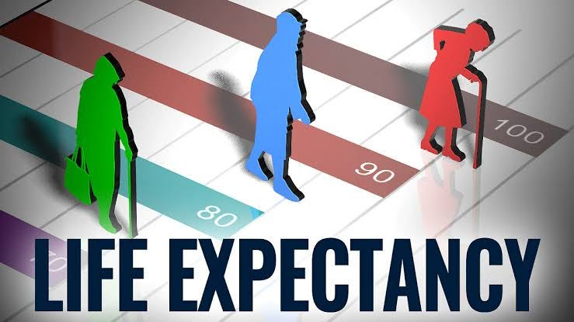
Introduction
What is Life Expectancy? Why do we care?
Life Expectancy is a key indicator of a country’s health and wellbeing, and economic development
Studies in the past have shown correlations between socioeconomic and health-related outcomes
Identifying the key determinants of life expectancy can inform us of improved resource allocation, for the betterment of society’s health

Slide 3
Project Goals
Main Goals:
1. Identify significant predictors of life expectancy
2. Compare performances and identifying best model
Additional Objectives:
3. Examine the discourse surrounding a country’s economic development
4. Attempt to assign labels to economic development

Slide 4
Literature Review 1
Deshpande et al. (2023)
“Life Expectancy using Data Analytics”
Uses a similar dataset to the one I use (the original WHO life expectancy dataset on Kaggle)
This dataset contains many null values. Their approach was to use the mean value of the column for numerical values, and mode for string features.
Multiple model comparisons including regressions (MLR and ML algorithms)
Random Forest Regressor was chosen for its highest accuracy
Best predictive power
Key predictors:
GDP per capita
Alcohol consumption
Prevalence of diseases
Immunization coverage
No cross-validation
No baseline model/method to compare (e.g. basic SLR)

Slide 5
Literature Review 2
Roffia et al. (2022)
Longitudinal study on OECD countries on determinants of life expectancy
Uses backward stepwise selection, and Arellano–Bond estimators to address endogeneity concerns. Also introduces lagged variables (1-5 years).
Cross-country FE multiple regression analysis
Key predictors:
Education
Public health services
Physician density
Hospital bed density
Stated limitations:
Data availability resulting in omitted variable bias (model may not include a potentially significant variable had the data been collected for it)
Limited to OECD countries, may not have the same explanatory power for other countries.

Slide 6
Data Source
https://www.kaggle.com/datasets/lashagoch/life-expectancy-who-updated/data
Dataset: Life Expectancy WHO (Updated)
Derived from another Kaggle dataset
Data sourced from WHO, World Bank, Our World in Data
Panel data
2000 - 2015 (16 years)
179 countries
2864 observations
Data Pre-processing
Addresses imputation methods
Country’s missing value in any year: closest 3-yr avg
Country’s missing value in all years: average of the Region
Omission of certain countries which were missing more than 4 columns/variables (14 countries)
Difficulty obtaining data

Slide 7
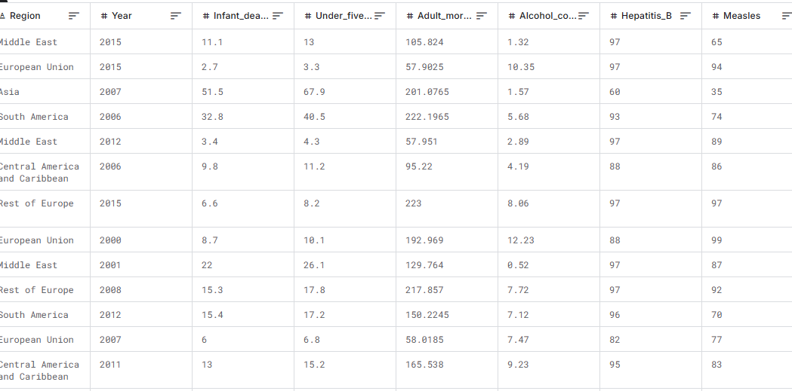
Snippet of Dataset

Slide 8
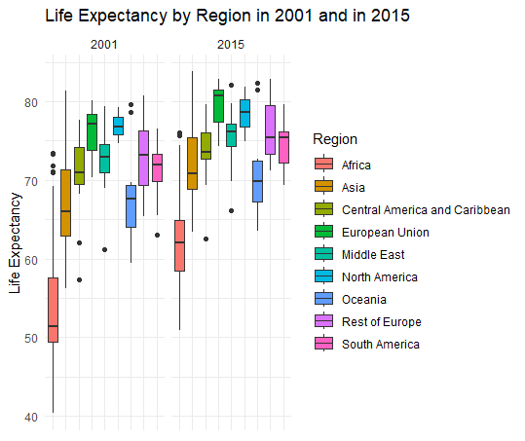
Exploratory Data Analysis
Life Expectancy by Region
Comparison of LE (Life Expectancy) by Region in 2001 and 2015
Good news! Overall increases in LE across all regions
Africa and Asia have the largest IQR and ranges
Great disparity between developed and developing countries
Potential difficulties in classifying economic development based on regions alone

Slide 9
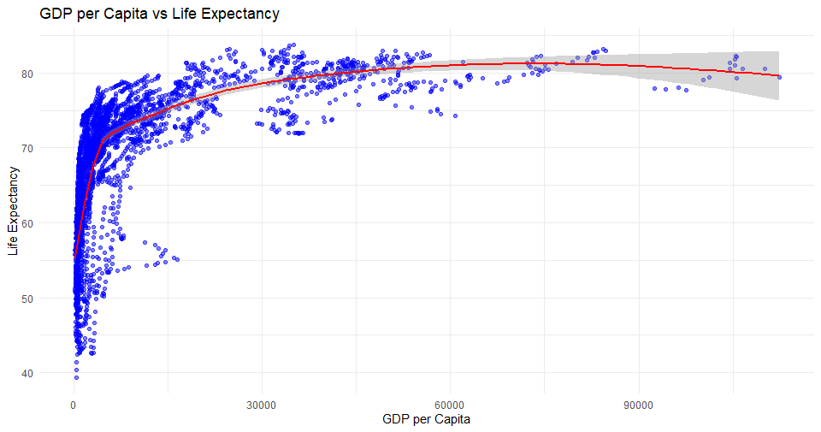
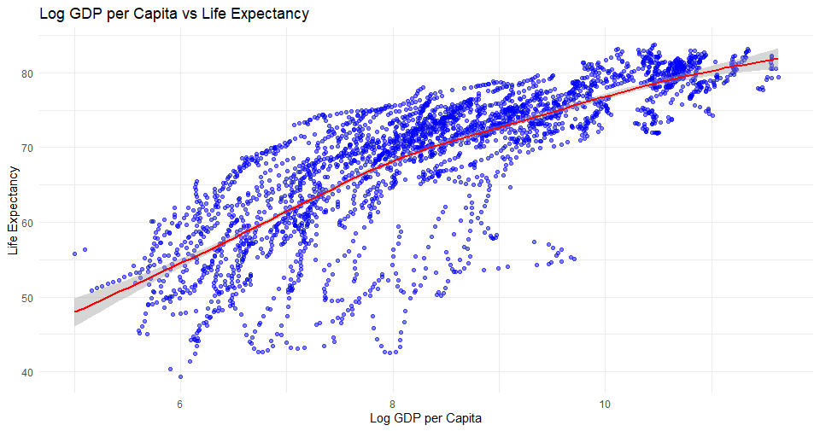
The GDP Per Capita Question
GDP per capita vs. LE
Log(GDP per capita) vs. LE
Shows a nonlinear relationship (clear diminishing returns for every unit increase in GDP)
Simpler
1% increase in GDP per capita on LE
Transformation is beneficial here
Log GDP is selected and replaces GDP/capita because of the nonlinear relationship

Slide 10
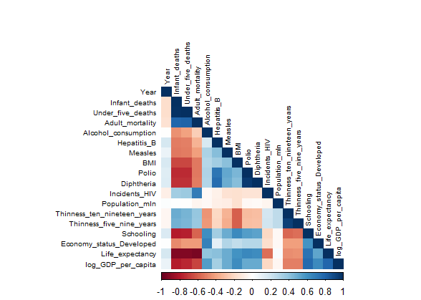
Exploratory Data Analysis
Correlation Matrix
Strong positive correlations:
Schooling vs. GDP per capita
Strong negative correlations:
Mortality factors among each other
Weak correlations:
Vaccination rates vs. economic development
To address multicollinearity proven by VIF, certain factors were removed

Slide 11
Methodology
Models to explore:
1. Linear Regression
2. AIC Stepwise Regression
3. KNN
4. LOESS
5. Random Forest
6. GBM Boosting
Time-aware train-test split of 80/20
Train: 2001 - 2012
Test: 2013 - 2015
Addresses time factor of dataset
Monte carlo cross validation (100 iterations) to ensure robustness
Parameter tuning is addressed
K-means clustering to observe how to identify a country’s state of economic development

Slide 12
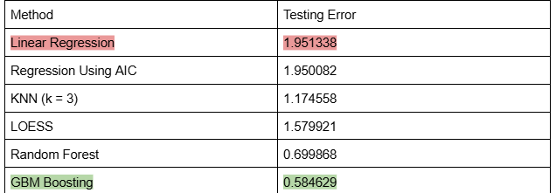
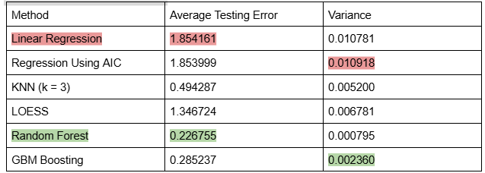
Results - Model Performance
Table 1: Single run TE
GBM best performer, followed by Random Forest
Linear Regression and AIC stepwise are the worst performers (baseline)
Dataset requires sophisticated modeling methods, beyond linear regression
Table 2: MCCV = 100, average TE and variance
Largely the same results, with RandomForest performing the best and GBM Boosting not far behind
Concurs with Literature Review 1

Slide 13
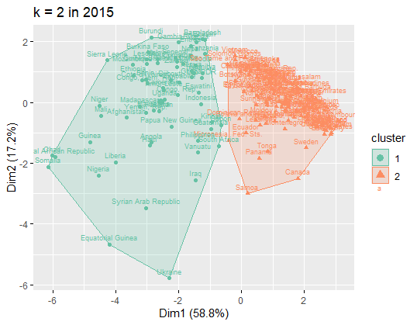
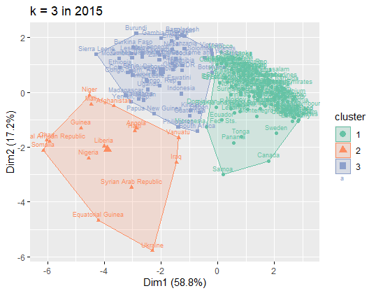
Results - Clustering
Only utilizes 2015 data because it is most recent, and would be a fairer comparison to the existing classification of the Developed variable sourced from the UN’s labeling choices in 2014. Features utilized: Country, Log GDP/capita, Schooling, Alcohol consumption, BMI, Hepatitis B, Diphtheria, Adult mortality, under five deaths
“Middle”
“Stronger”
Developed
Developing
“Weaker”

Slide 14
Results - Clustering (cont.)
Clustering Analysis
Used the silhouette method to find an optimal of k = 2, but also compared with k = 3 results
K = 2 compared to Developed variable
TN = 63, FN = 0, TP = 37, FP = 79
Accuracy = 56%, Precision = 32%, Recall = 100%, F1 score = 48%
63 developing countries correctly identified as developing (true negatives), and no developed countries wrongly identified (no false negatives)
Lots of false positives. Excellent at identifying what falls under developing, but not great at distinguishing which countries are developed according to the UN.
K = 3 compared to Developed variable
Cluster 1 = stronger, cluster 2 = weaker, cluster 3 = middle
Cluster 1: All 37 developed, and 75 developing (Likely label: high & medium-high development)
Cluster 2: 16 developing (Likely label: low development)
Cluster 3: 51 developing (Likely label: medium development)

Slide 15
Conclusion
Key factors: logGDP/capita, schooling, adult mortality rate, under 5 mortality rate, DTP3 and Hep B vaccination rates, BMI, alcohol consumption
Similar to issues faced in Literature Review, the dataset faces constraints of missing possibly meaningful determinants that were not included in the dataset
Tree-based models performed much better than linear methods in predicting life expectancy
MCCV bolsters the results of tree-based methods
Need to consider more nonlinear approaches (many I.I.D. violations) when dealing with Panel Data
K-means clustering revealed 2 and 3 possible groups based on a combination of socioeconomic and health factors
Compared to UN’s 2-cluster system, excellent recall but low precision and accuracy

Slide 16
Future Improvements
Explore Panel Data analysis and learning (FE, RE, Mixed)
Conduct similar research on recent years (Covid era)
Introduce time-series analysis, given the nature of panel data
Explore more determinants (e.g. warfare, physician density)
Observe and compare other classifications and clustering approaches for economic development
e.g. World Bank classifies based on GNI and has 4 levels
Research ideal labeling based on the clustering analysis

Slide 17
References
Deshpande, Dr. R., & Uttarkar, V. (2023). Life expectancy using data analytics. International Journal for Research in Applied Science and Engineering Technology, 11(4), 972–978. https://doi.org/10.22214/ijraset.2023.50140
Roffia, P., Bucciol, A., & Hashlamoun, S. (2022). Determinants of life expectancy at birth: A longitudinal study on OECD countries. International Journal of Health Economics and Management, 23(2), 189–212. https://doi.org/10.1007/s10754-022-09338-5

